Slide 1
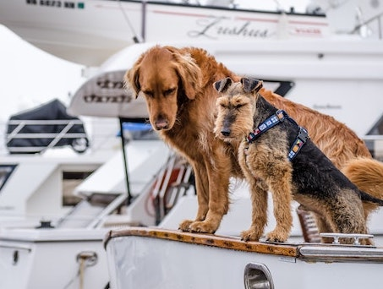
pet fly
A pet-centric flight booking platform offering seamless, stress-free travel solutions for pets and their owners.
Warm and Friendly: Use soft, calming colors
Trust & Security: Emphasize pet safety, showing clearly outlined procedures for air travel and professional handling.
Simplicity: A clean, intuitive layout with easy navigation.

Slide 2

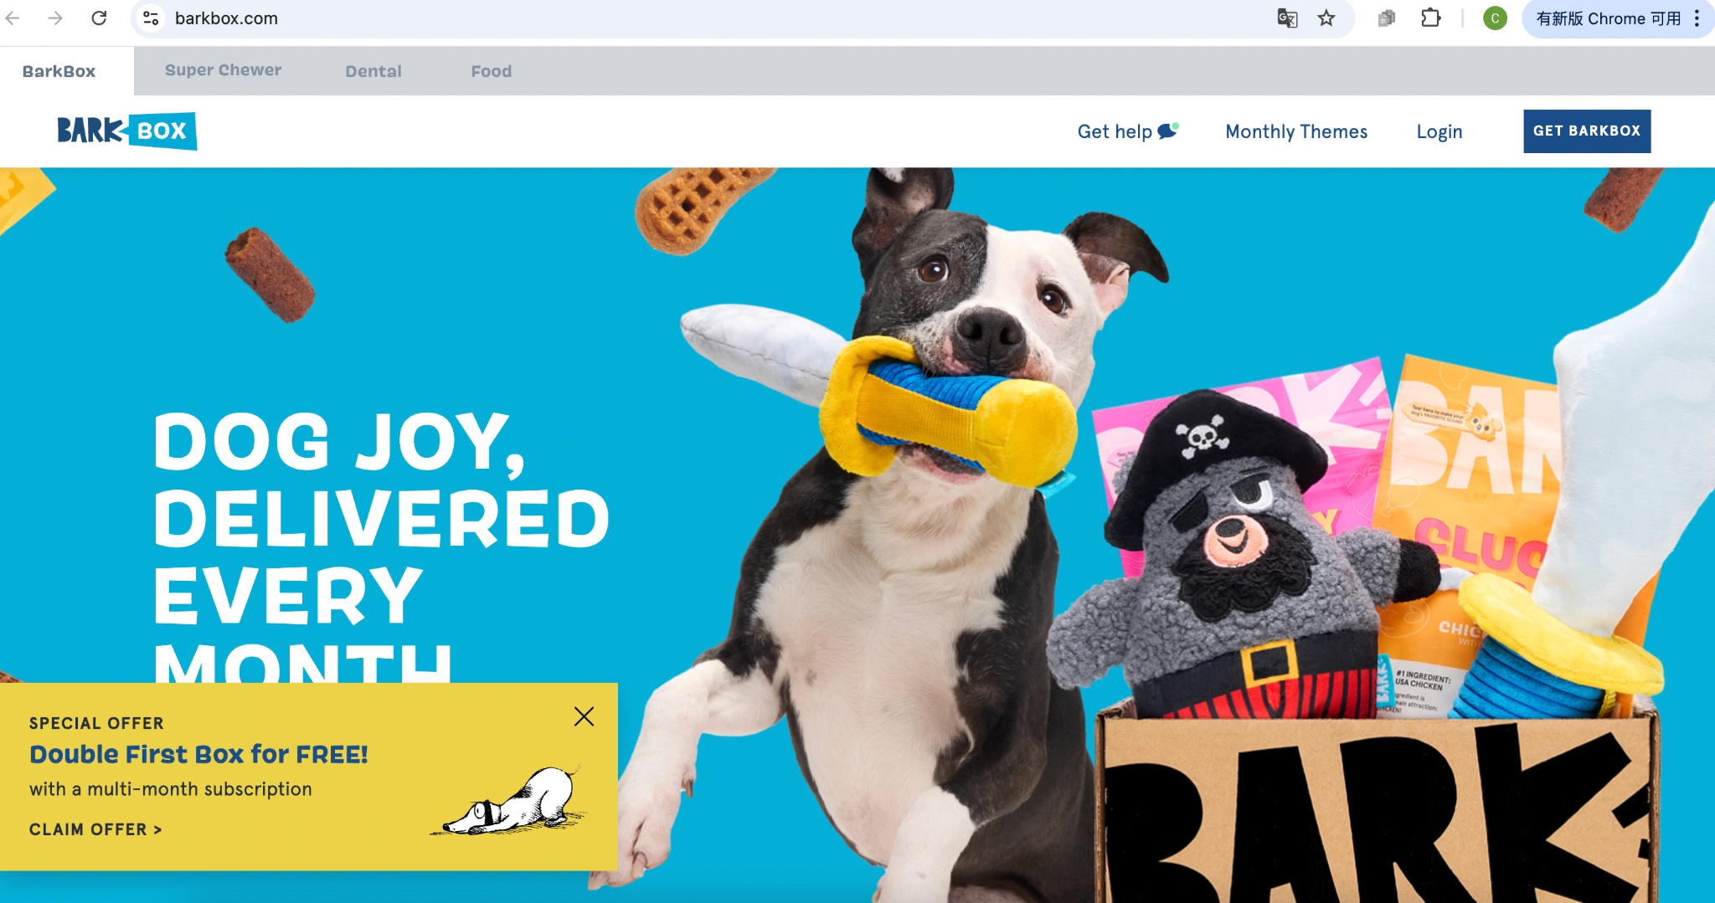

Existing Website:
https://www.barkbox.com/

Slide 3
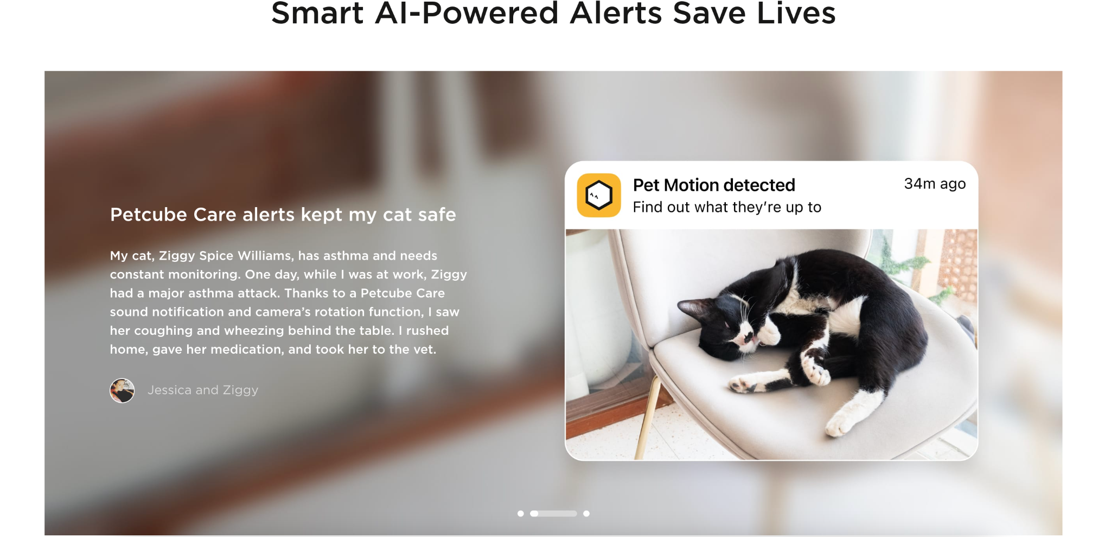
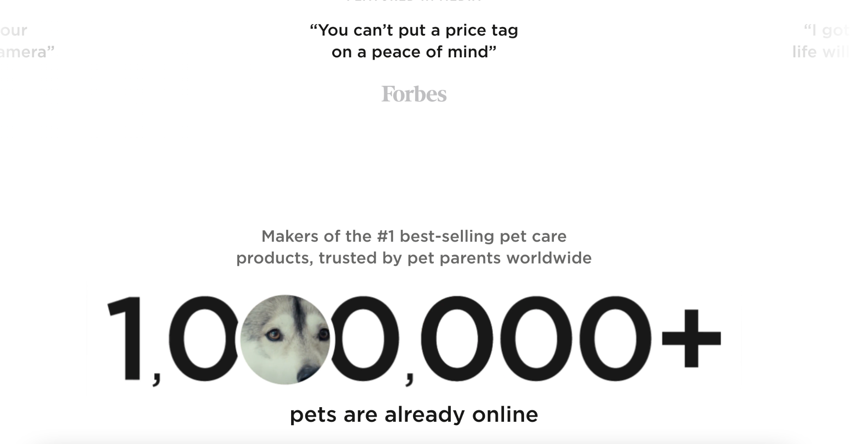
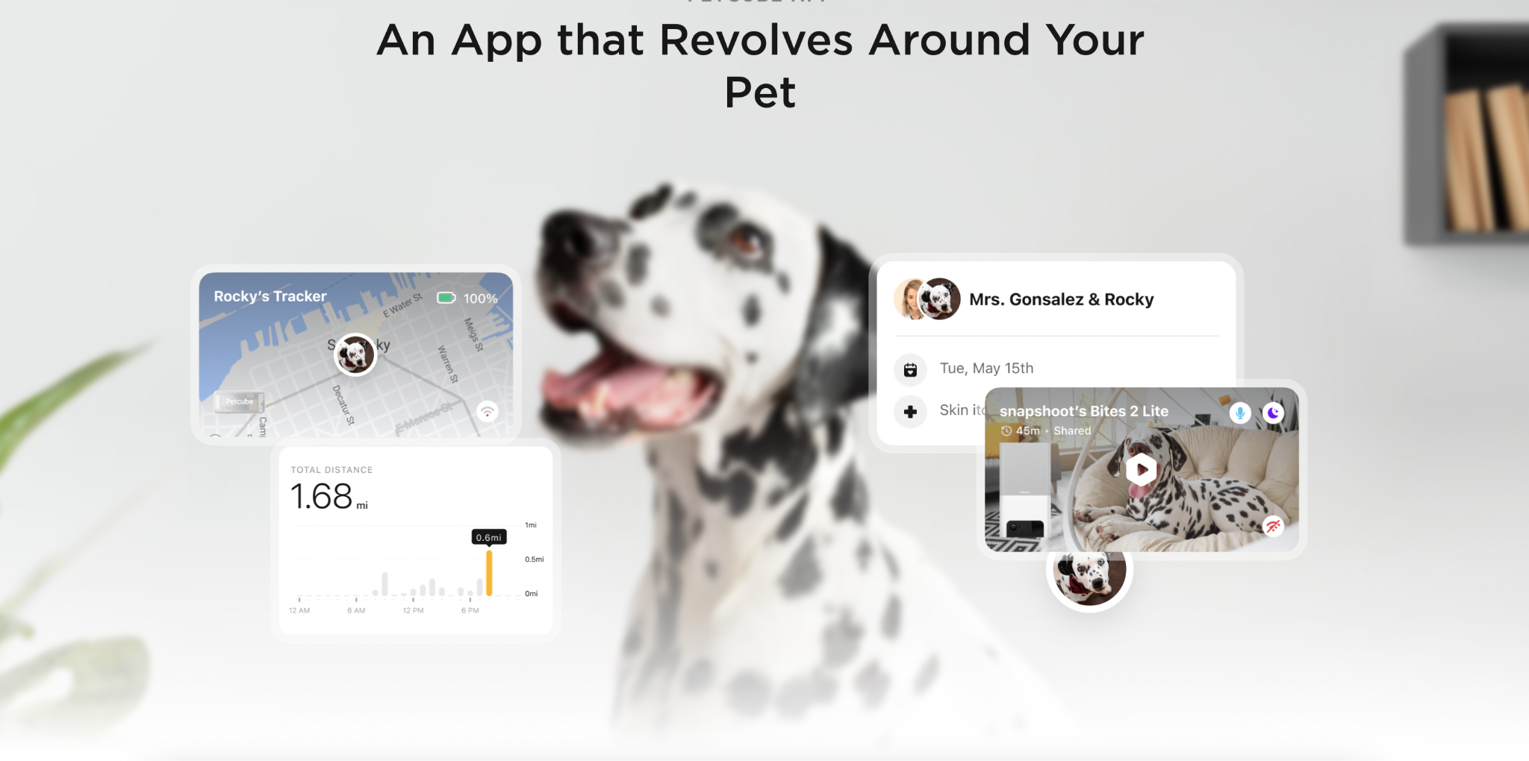
Existing Website:
https://petcube.com/

Slide 4
Covered skills:
Navigation bar
Colors and Backgrounds
Styling Text
Link pictures
Box Model: Margins, padding, borders, and content.
Positioning
Transitions
Hyperlinks

Slide 5
Skills I should learn:
Dynamic effect
How to insert video
How to make a picture clickable

Slide 6
wireframe

Slide 7
